Slide 1
Small Electric Generating Units in the MARAMA Alpha 2011/2018 Modeling Platform
A Methodology to Develop A Consistent Base Year Temporal Profile for Small Non-CAMD EGUs in the MANEVU+VA Region
Update for 2016 Modeling Platform EGU Workgroup Call 4/26/18

Slide 2
Purpose
In development of the MARAMA Alpha modeling platform, there has been interest in how SMOKE processes small electric generating units and whether or not the model is getting peak day emissions right.
These small units typically operate for limited periods of time. They usually operate during high electricity demand periods (aka peak day) or when larger units are offline for maintenance. They may also operate at times where it is necessary to ensure grid reliability.
Large units operating profiles are developed from CEMS data, so we know their profiles are reasonable but what about the smaller units – those without CEMS?
Our goal is to develop a temporal profile for coal, oil and gas-fired electric generating units < 25 MW at EGU facilities.
Based on what we know about their typical operational patterns, profiles for these units should show limited annual operation, but high peak day operation.

Slide 3
Which Units in the Inventory?
EPA identifies units in the ptEGU sector by matching emissions in the 2011 NEI point inventory to units found in the NEEDS database. Sources not matched to units found in NEEDS are placed into the pt_oilgas or ptnonipm sectors and are temporalized by default profiles in SMOKE
Sources are matched to NEEDS using EPA’s NEI to NEEDS crosswalk. Note that because these are small sources that are not often reviewed, they may not have full entries in EPA’s crosswalk. Many of these units end up in the ptnonipm sector.
For sources that do match to the NEEDS database but do not have CEMS, EPA applies a temporal profile using fuel and IPM region-specific CEMS data
2011/2018 MARAMA Alpha modeling platform split EPA’s ptEGU file into ERTAC EGU (units with CEMS grown by ERTAC EGU model) and smallEGU (units in EPA’s EGU sector but not grown by ERTAC)
For sources in the smallEGU sector, the MARAMA Alpha platform uses default SMOKE profiles for temporalization. These are the same profiles used for the ptnonipm sector.
MDE’s temporalization effort includes sources in MARAMA Alpha’s smallEGU and ptnonipm sectors

Slide 4
What Kinds of Units? MD Examples
ORIS ID | Facility | Unit IDs | Total Size (MW) | Fuel | Unit Types | Total 2011 NOx Emissions (Tons) | MARAMA Alpha Inventory File
6565 | Berlin | 1A - 5A | 8.55 | Oil | RICE | 4.36 | ptnonipm
1552 | Crane | GT1 | 14 | Oil | CTs | 5.41 | ptnonipm
1571 | Chalk | GT1 | 18 | Oil | CTs | 3.08 | smallEGU
1563 | Crisfield | CRIS, CRS2 – 4 | 10 | Oil | RICE | 9.20 | ptnonipm
1572 | Dickerson | GT1 | 13 | Oil | CTs | 1.30 | ptnonipm
1580 | Easton | 8 – 9, 11, 101 – 102 | 31.9 | Oil | CTs | 58.88 | ptnonipm
1580 | Easton | 7, 10, 12 - 14 |  | Oil | RICE
4257 | Easton 2 | 21 – 24, 201 – 202 | 37.64 | Oil | RICE | 86.58 | ptnonipm
4257 | Easton 2 | 203 - 204 |  | Oil | CTs
1573 | Morgantown | GT1 - 2 | 40 | Oil | CTs | 19.81 | smallEGU
1555 | Notch Cliff | GT1 - 8 | 136 | Gas | CTs | 85.89 | ptnonipm
1557 | Philadelphia | GT1 - 4 | 64 | Oil | CTs | 24.80 | ptnonipm
1559 | Riverside | CT7 - 8 | 22 | Oil | CTs | 5.20 | smallEGU
1564 | Vienna | 10 | 17 | Oil | CTs | 2.22 | ptnonipm
1554 | Wagner | GT1 | 12.9 | Oil | CTs | 2.67 | ptnonipm
Only 5 of MD’s 48 small non-CAMD EGUs are captured in EPA’s EGU sector. The remaining units were unable to match to NEEDS.
*Note that although sources within MD are all oil or gas-fired CTs and RICE, MDE has identified small non-CAMD EGUs of other unit/fuel types in other states (including some small coal-fired boilers).

Slide 5
Overview of MDE’s Process
Step 1: Identify the 2011/2018 temporal profiles for base and peaking EGUs >25MW.
Step 2: Identify the 2011/2018 temporal profiles currently assigned by SMOKE to small EGUs <25MW.
Step 3: Apply the temporal profile for large peaking EGUs (identified in step 1) to small EGUs <25MW.
Compare the daily NOx mass allocated by current SMOKE profiles for small EGUs vs. the MDE-developed profiles.

Slide 6
Step 1 – Identify Base and Peaking Profiles For Units >25MW
Downloaded daily heat input data for 2011 from CAMD. Separated by fuel-type and region.
Coal, oil and gas
MANEVU, LADCO, SESARM and CENSARA
Graphed the daily distribution of heat input (the fraction of the annual value).
EPA has created a separate modeling file identifying peaking units that are > 25MW. These are units that are in both the NEI and CAMD, and were identified as peaking units because they had a capacity factor <10% over a 3 year average, and < 20% in each of 3 years (2010-2012). Note that EPA no longer separates peaking EGUs in subsequent modeling platforms.
Graphed the daily distribution of heat input for the peaking units (by region and fuel-type). Overlaid the peaking profiles on the total fuel-type region profiles.
Do the profiles match – are the peaking units running on peak days?

Slide 7
Notes:
Peaks in January/February make sense; they may be due to shutdown of larger units for maintenance.

Slide 11
EPA’s Temporalization Process
Sources in the ptegu and ptegu_pk sectors contain emissions from EGUs in the 2011 NEI point inventory that could be matched to units found in the NEEDS database. Sources not matched to units found in NEEDS are placed into the pt_oilgas or ptnonipm sectors and are temporalized by SMOKE
For PtEGU sources matched to CEMs
Use the hourly CEMS values for NOx and SO2 . SMOKE temporalizes other pollutants by applying the hourly heat input patterns to the annual inventory values.
For PtEGU Sources not matched to CEMS
The allocation of the annual-to-month emissions are done using average fuel-specific season-to-month factors generated for each of the 64 IPM regions. These factors are based on 2011 CEMS data. In each region, separate factors are developed for coal, natural gas and “other”, where the types of fuels included in other vary by region. Separate profiles were computed for NOx ,SO2 and heat input (to be used as a surrogate for all other pollutants).
Emissions were then allocated from month-to-day using IPM region and fuel specific average moth to day factors based on 2011 CEMS heat input only. In each region, separate factors are developed for coal, natural gas and “other”, where the types of fuels included in other vary by region.
Temporal profiles form days to hours are computed based on the region and fuel specific average day to hour factors derived from CEMS data for those fuels and regions using data from the entire year.
Allocation of annual-to-month and month-to-day factors are done outside of SMOKE. SMOKE takes the daily values and allocates the emissions to the hours.
An overall composite profile was also computed and was used in a few cases in which the fuel-specific profile was too irregular or there was no CEMS units with the specified fuel in the region containing the units.
For ptnonipm Sources
Temporal allocation is completed by SMOKE using the “mwdss” temporal approach
Hourly remissions for one representative Monday, representative weekday (Tuesday through Friday), representative Saturday and representative Sunday for each month
Variation between Mondays and other weekday, Saturdays and Sundays within the month, not week to week variation within the month.

Slide 12
Comparison of Temporalization Processes
MDE Temporal Process
EPA Temporal Process
Used raw daily CEMS data to develop profiles based on heat input
Developed a single profile for all pollutants
Coal, oil and gas fuel bins
4 modeling regions, 3 fuel bins = 12 profiles
Used season-to-month, month-to-day data from IPM, based on CEMS data, but also using average summer/winter day data
Developed profiles for NOx, SO2, and heat input as a surrogate for other pollutants
Coal, gas, and other fuel bins
64 regions, 3 fuel bins, 3 profiles each = 576 profiles
But Maryland takes the process one step further. While EPA is looking for an “average” profile, MDE believes that a more limited or peaking profile is more representative of how these small nonCAMD EGUs operate.
Notes:
Monthly values undergo a multi-step temporal process to yield the hourly emissions at each unit: summer/winter value to month, month to day and day to hour. For units not matched to CEMS data the first two steps are done outside of SMOKE. SMOKE takes the daily values and allocates the emissions to the hours.

Slide 13
EPA profile shown is an aggregate of all oil-fired non-CEMS EGUs in the MANE-VU+VA region.

Slide 14
EPA profile shown is an aggregate of all gas-fired non-CEMS EGUs in the MANE-VU+VA region.

Slide 15
Are the MDE-Developed Temporal Profiles Accurate?
Collected 2011 daily heat input data for MD small EGUs from EGU facilities.
Separated by fuel type (oil or gas).
Graphed daily heat input distribution (fraction of annual value).
Overlaid MDE-developed temporal profile for MANEVU gas and oil.
Do the profiles match- are MDE temporal profiles representative of small EGU operating patterns?

Slide 16
Will be updated as facilities submit data.
Units submitted as of 7/1/2015:
Philly Rd 1-4
Riverside 7-8
CP Crane CT
MDE-developed profiles match up well with operational data: peaks are occurring on similar days.
Differences in the magnitude of peaks or operating days are likely a function of averaging a large universe of units from the MDE profiles, versus the actual data collected from the small number of MD-only units.

Slide 17
Units submitted as of 7/1/2015:
Notch Cliff 1-8
MDE-developed profiles match up well with operational data: peaks are occurring on similar days.
Differences in the magnitude of peaks or operating days are likely a function of averaging a large universe of units from the MDE profiles, versus the actual data collected from the small number of MD-only units.

Slide 18
Step 2 – Identify Profiles Assigned to Units < 25MW
The MARAMA 2011/2018 Alpha modeling inventory took the USEPA V2 point EGU and point nonIPM inventory files, and separated them into ERTAC EGUs, nonEGUs (labeled ptnonipm) and small EGUs. The units of interest are in the small EGU and the nonEGU files.
Using EMF, identified facilities in the smallEGU and ptnonipm files with NAICS codes for EGUs.
From the selected facilities, identified units with SCCs associated with coal, oil and gas-fired units.
Also included units with SCCs for ICI boilers, as NAICS code was used to determine if that unit is at an EGU facility
Included SCCs for both boilers and ICEs in the small EGU file to capture as many units as possible. Included only ICEs from the ptnonipm file to prevent capture of auxiliary boilers, industrial processes, etc.
Placed the identified units in a new file named “nonERTAC small EGU”
To assess any possibility of double counting, used Access to match units in the ERTAC modeling file, based on Agency Facility ID, Unit ID, Release Point, Process and SCC to units in the nonERTAC small EGU file.
To prevent nonEGUs from being temporalized using the MDE profiles, used Access to match units designated as nonEGUs in the Sabo Crosswalk, based on EIS Facility ID, Unit ID, Process, Release Point and SCC to units in the nonERTAC Small EGU file.
Because the smaller electric generating units do not have hourly emissions data, a default temporal profile (supplied by EPA) is applied (by SCC and FIPS) to the annual emissions in SMOKE.
209 SCC codes
85 for coal; 9 distinct profiles
69 for gas; 20 distinct profiles
55 for oil; 15 distinct profiles
Used the SMOKE Temporal Cross Reference file “all sectors” tab to cross reference between emissions sources and temporal profiles by SCC and FIPs to select emissions profiles in the Temporal Profile file.
Graphed the temporal profiles assigned to small EGUs by SMOKE, by SCC groups (coal, oil and gas). Overlaid the SMOKE profiles on the peaking profiles and the base load profiles.
Does the profile assigned to the small EGUs in SMOKE align with the “peaking” profiles developed in the previous step?
Notes:
To approximate how many small units may not be properly represented in the model, we identified coal, oil and gas-fired electric generating units sized <25 MW from the IPM 5.13 results.
Approximately 3,481 coal, oil and gas-fired units in 34 states.
NAICS/SCC sorting methodology identified 2,438 potential units for temporalization
No coal-fired peaking units in the MANEVU+VA region
MANEVU+VA – Double Counting
Oil – 7 Units, 26.25 Tons
Gas – 11 Units, 559.67 Tons

Slide 21
Is It Worth It?
Region |  | Number of Units | Fuel |  | 2011 Annual NOx Mass (Tons)
MANEVU+VA |  | 544 | Coal |  | N/A
 |  |  | Oil |  | 774.01
 |  |  | Gas |  | 404.89
MANEVU+VA Total |  |  |  |  | 1,178.90
LADCO | 864 |  |  | Coal | 5,216.69
 |  |  |  | Oil | 717.18
 |  |  |  | Gas | 1,188.75
LADCO Total |  |  |  |  | 7,122.61
SESARM | 359 |  |  | Coal | 225.00
 |  |  |  | Oil | 254.16
 |  |  |  | Gas | 1,538.66
SESARM Total |  |  |  |  | 2,017.82
CENSARA | 658 |  |  | Coal | 3,185.90
 |  |  |  | Oil | 731.39
 |  |  |  | Gas | 1,705.80
CENSARA Total |  |  |  |  | 5,623.09
Total | 2,425 |  |  | Coal | 8,627.59
 |  |  |  | Oil | 2,476.73
 |  |  |  | Gas | 4,838.10
Grand Total NOx Mass |  |  |  |  | 15,942.42
The proportion of emission attributed to fuel types varies by region. In some instances, coal is still “king”, but the importance of emissions from other fuel types varies drastically. For example, in SESARM, emissions from small gas-fired units have the largest impact and emissions from coal and oil-fired units are nearly equal. Conversely, in MANEVU+VA emissions from oil-fired units have the largest impact and emissions from gas-fired units have a lesser impact.
15,942 Tons of NOx is not a significant amount of mass to be concerned about. The top 3 NOx emitters in 2011 could easily emit more NOx than all of the 2,438 units identified in this analysis. But where that NOx mass is allocated temporally is very important.

Slide 22
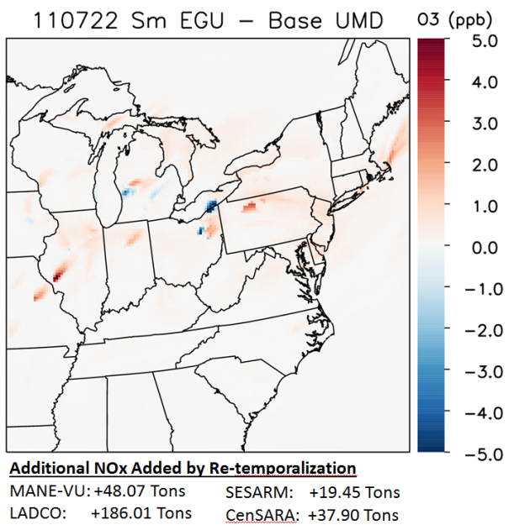
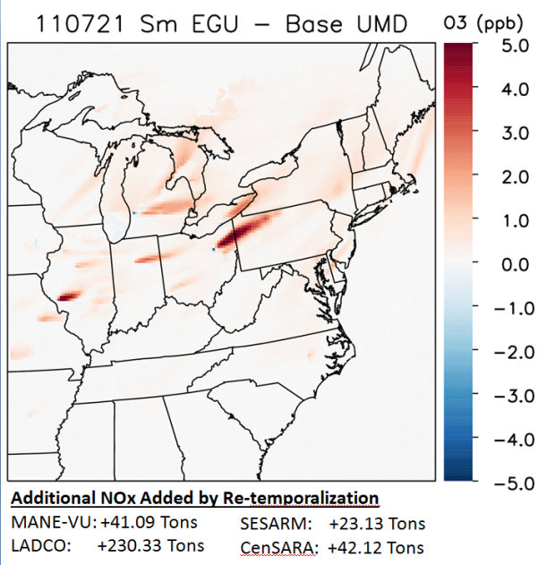
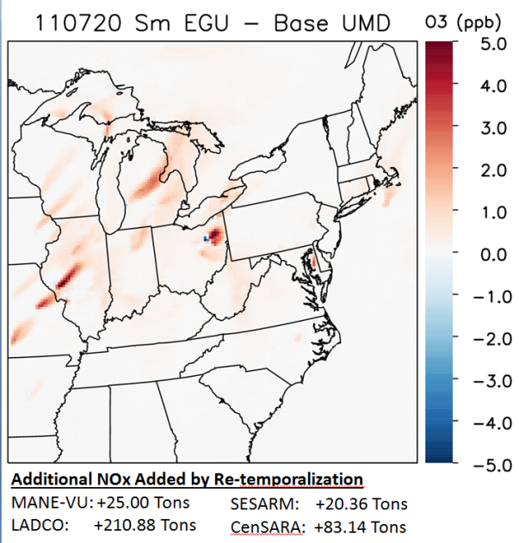
Photochemical Modeling Results
University of Maryland completed two CMAQ runs for July 2011
Base: using SMOKE default temporal profiles
Sm EGU: using MDE-developed temporal profiles for small EGUs
Re-temporalization had impact of up to 5 ppb in some areas on certain days
Also note some areas of NOx titration

Slide 23
The Universe of Units is Different – Peak Day Impact May be Very Different
Units selected for EPA’s temporalization scheme (not SMOKE’s) are in the ptegu files
MDE used a series of queries to identify EGUs by SCC/NAICs codes in the MARAMA Alpha SmallEGU and the ptnonipm files
Because MDE is examining two different files, and is sorting based on SCC/NAICS and not on source-to-emissions matching, the MDE universe of units is much larger.
A larger universe of units, coupled with a more “peaky” profile means that the MDE temporalization scheme will likely show a greater peak day impact than the EPA scheme.

Slide 24
There are 40 oil-fired small EGUs in Maryland
*Note MDE methodology captured 32 of the 40 oil-fired units.
4 Maryland Units are included in the EPA ptipm nonCEM file:
Riverside 7
Chalk Point CT1
Morgantown CT1-2
The remaining 36 oil-fired small EGUs in Maryland were not temporalized using EPA's ptipm nonCEM profiles. These units are in the ptnonipm sector, which per EPA's documentation (2011 v6.1 TSD Section 2.1.1), was temporalized using SMOKE's default profiles.

Slide 25
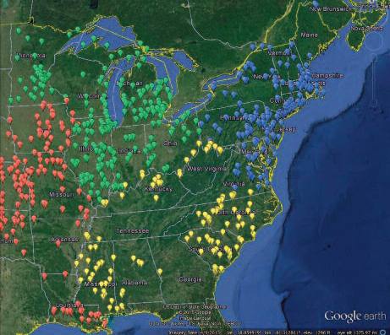
Next Steps…Improvements for the 2016 Modeling Platform
MDE has already developed a list of non-CAMD EGUs based on the 2011 modeling platform. This list of non-CAMD EGUs has been reviewed by many states.
May require some updating for the 2016 platform, as there may be new units and some units may have retired.
Previous work only covered states in the eastern modeling domain. Need to expand to western states.
MDE has developed 2016 temporal profiles for all 12 region/fuel bins, using the same parameters for “peaking units”
If workgroup is interested, MDE can work with EPA to incorporate these profiles into the 2016 modeling platform.

Slide 26
State Comment Checklist
Region | State | Submitted?
MANE-VU | CT | x
 | DC
 | DE | x
 | MA | x
 | MD | x
 | ME | x
 | NH | x
 | NJ | x
 | NY | x
 | PA | x
 | RI
 | VA | x
 | VT
SESARM | AL
 | FL
 | GA | x
 | KY
 | MS
 | NC
 | SC
 | TN
 | WV
Region | State | Submitted?
CenSARA | AR | x
 | IA | x
 | KS
 | LA
 | MO | x
 | NE
 | OK
 | TX | x
LADCO | IL
 | IN
 | MI
 | MN
 | OH
 | WI
States were asked to
Mark "Y" in the appropriate column if the unit:
-Feeds power to the grid
-Has a capacity less than 25 MW
-Is fired by either coal, oil, or natural gas
Mark "N" in the appropriate column if the unit:
-Is not an EGU (does not feed power to the grid)
-ex. auxiliary boilers, emergency generators
-Is an ERTAC unit that may be double-counted
-Is not fired by either coal, oil, or natural gas
-ex. landfill gas, municipal waste combustors

Slide 27
1800 Washington Boulevard | Baltimore, MD 21230-1718 410-537-3000 | TTY Users: 1-800-735-2258 www.mde.state.md.us
Maryland Department of the Environment
Air Quality Planning Program

